Slide 1
ALGORITHMS Algorithm Analysis - Part2
Asma Fariha
Lecturer, Department of Computer Science
American International University-Bangladesh (AIUB)
asma.fariha@aiub.edu

Slide 2
Growth of Functions and Asymptotic Notation
When we study algorithms, we are interested in characterizing them according to their efficiency.
• We are usually interested in the order of growth of the running time of an algorithm, not in the exact running time. This is also referred to as the asymptotic running time.
• We need to develop a way to talk about rate of growth of functions so that we can compare algorithms.
• Asymptotic notation gives us a method for classifying functions according to their rate of growth.

Slide 3
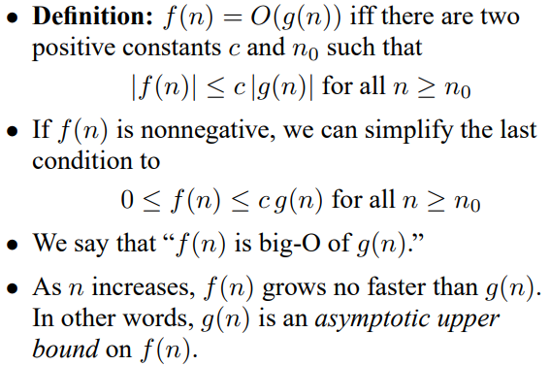
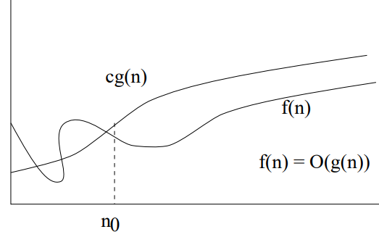
Big-O Notation

Slide 4
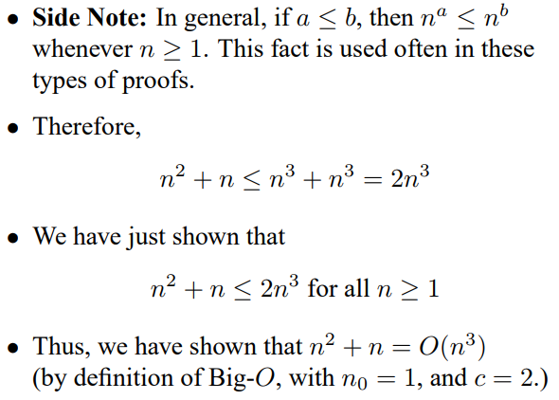
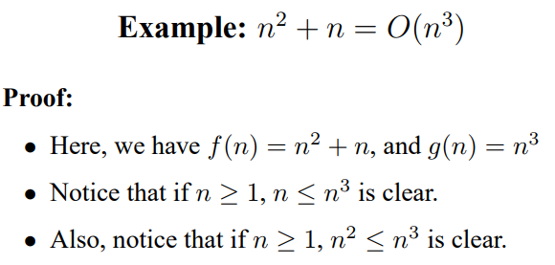
Big-O Example 1

Slide 5
Big-O Example 2
Show 3n² + 4n - 2 = O(n²) (Another approach)
We need to find c and n₀ such that:
3n² + 4n - 2 <= cn² for all n >= n₀ .
Divide both sides by n², getting:
3 + 4/n - 2/n² <= c for all n >= n₀ .
If we choose n₀ equal to 1, then we need a value of c such that:
3 + 4 - 2 <= c
We can set c equal to 6. Now we have:
3n² + 4n - 2 <= 6n² for all n >= 1

Slide 6
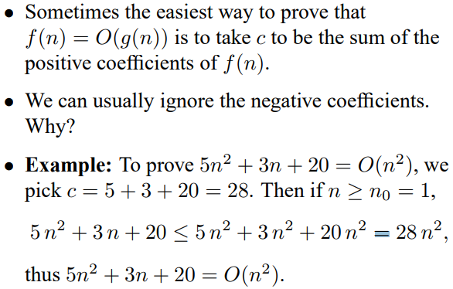
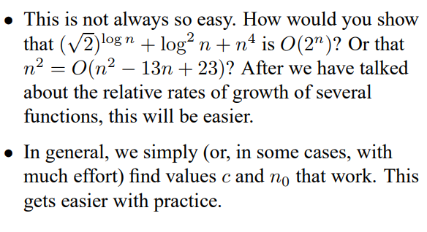
Strategies for Big-O

Slide 7
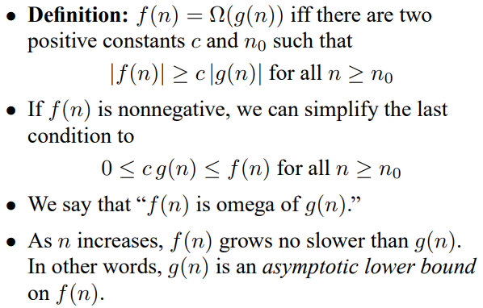
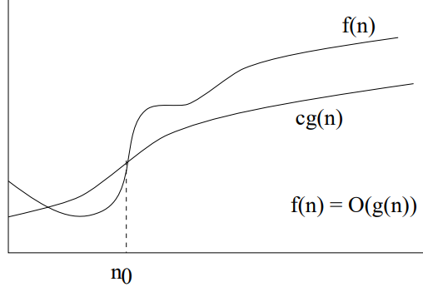
Big-Ω notation

Slide 8
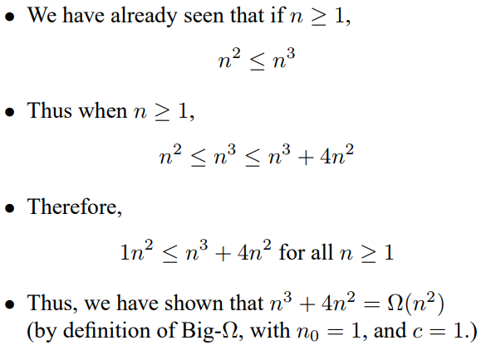
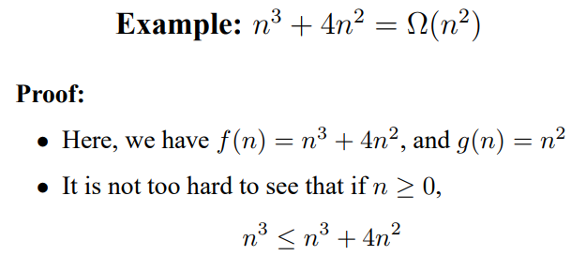
Big-Ω Example

Slide 9
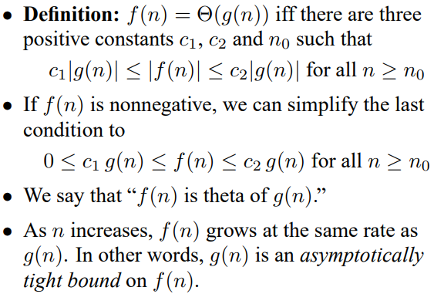
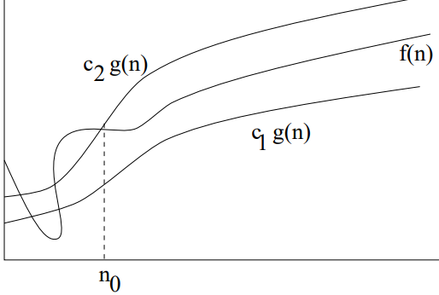
Big-Θ notation

Slide 10

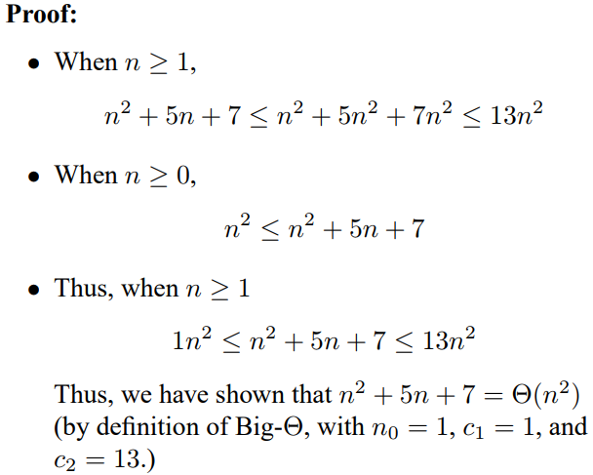
Big-Θ Example

Slide 11
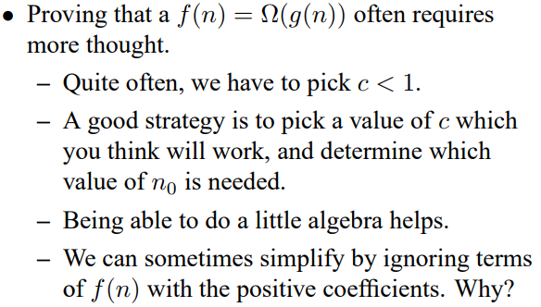
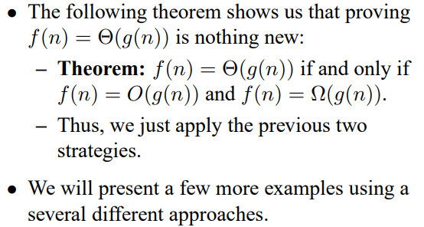
Strategies for Ω and Θ

Slide 12

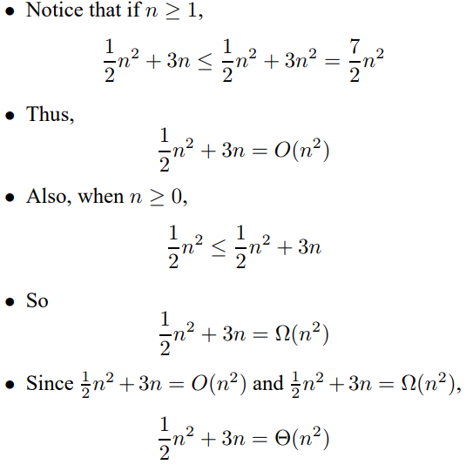

Slide 13
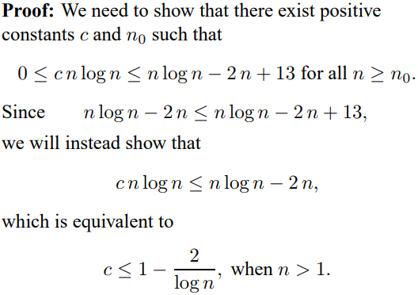
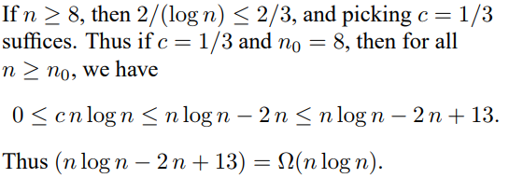

Slide 14

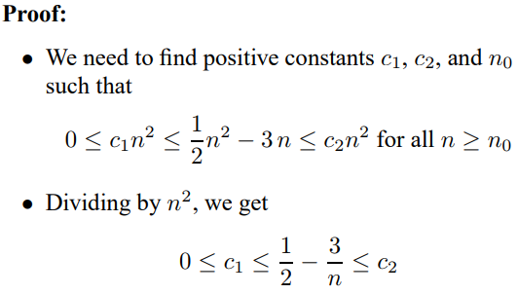
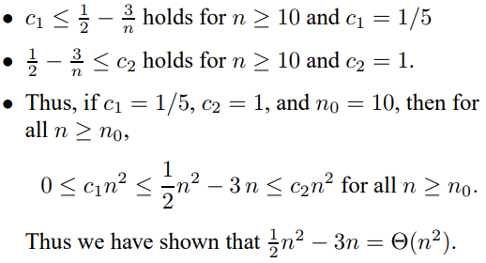

Slide 15
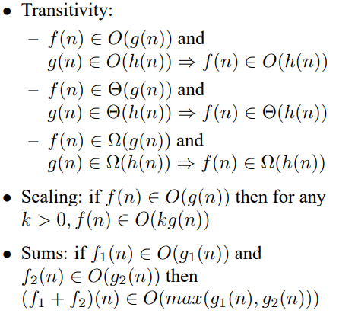
Arithmetic of Big-O, Ω, and Θ notations

Slide 16
Logarithms and properties
In algorithm analysis we often use the notation “log n” without specifying the base
Binary logarithm
Natural logarithm

Slide 17
More Examples
For each of the following pairs of functions, either f(n) is O(g(n)), f(n) is Ω(g(n)), or f(n) = Θ(g(n)). Determine which relationship is correct.
f(n) = log n²; g(n) = log n + 5
f(n) = n; g(n) = log n²
f(n) = log log n; g(n) = log n
f(n) = n; g(n) = log² n
f(n) = n log n + n; g(n) = log n
f(n) = 10; g(n) = log 10
f(n) = 2^{n}; g(n) = 10n²
f(n) = 2^{n}; g(n) = 3^{n}
f(n) = Θ (g(n))
f(n) = Ω(g(n))
f(n) = O(g(n))
f(n) = Ω(g(n))
f(n) = Ω(g(n))
f(n) = Θ(g(n))
f(n) = Ω(g(n))
f(n) = O(g(n))

Slide 18
Common Summations
Arithmetic series:
Geometric series:
Special case: |x| < 1:
Harmonic series:
Other important formulas:

Slide 19

Classification Summary
We have seen that when we analyze functions asymptotically:
• Only the leading term is important.
• Constants don’t make a significant difference.
• The following inequalities hold asymptotically:
• In other words, an algorithm that is Θ(n log(n)) is more efficient than an algorithm that is Θ(n 3 ).

Slide 20
Reference
CLRS
Chapters: 1, 2 (2.1, 2.2), 3
Exercises: 1.2-2, 1.2-3, 2.1-3, 2.1-4, 2.2-1, 2.2-3, 3.1-1, 3.1-4, 3.1-6, 3.1
Problems: 1-1, 3-3
HSR
Chapters: 1 (1.1-1.3)
Examples: 1.4-1.6, 1.11-1.13, 1.17-1.18
Exercises: 1.3 (1-4, 8, 9)

